Slide 1

Team Name : Vision Guardians
Team Leader Name : Rajesh Gheware (https://rajeshgheware.github.io)
Problem Statement : Prevent diabetes complications and blindness in 89.8 million Indians facing severe specialist shortages (80% doctors in urban areas) through mobile-first AI-powered diabetic retinopathy screening and personalized glucose management.

Slide 2
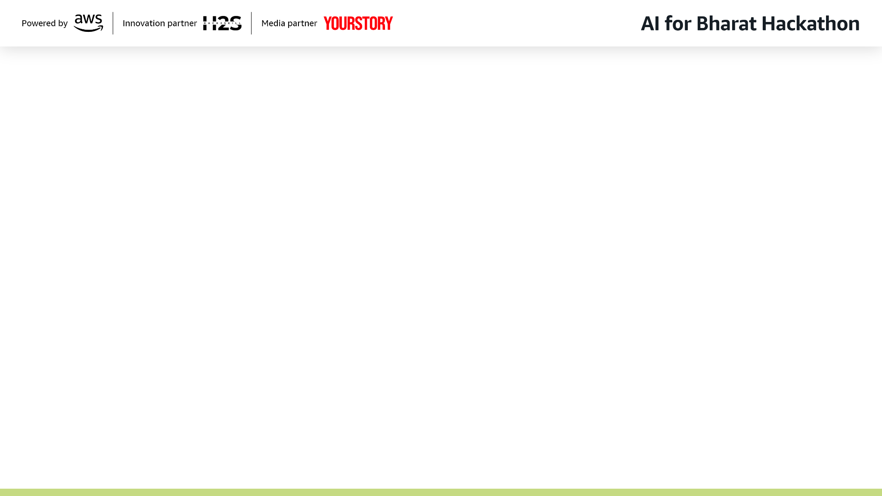
Brief about the Idea:
DiabetCare AI is a mobile-first Progressive Web App that empowers India's 89.8 million diabetics to prevent complications and blindness through AI-powered early detection and personalized management. The app addresses India's critical healthcare crisis where 80% of doctors serve only 35% of the urban population, leaving rural diabetics with zero access to endocrinologists or ophthalmologists. By leveraging smartphone cameras for diabetic retinopathy (DR) screening using Amazon Rekognition Custom Labels, patients can detect vision-threatening complications before irreversible damage occurs—preventing 80% of diabetes-related blindness that is medically preventable. The AI achieves 92%+ sensitivity in DR detection, matching specialist-level accuracy while being accessible from any smartphone without clinic visits.
Beyond screening, DiabetCare AI delivers continuous diabetes management through AWS Bedrock-powered features: a smart glucose tracker with pattern recognition, an AI meal analyzer using Amazon Nova Pro for Indian food carbohydrate estimation (photo-based), and a 24/7 multilingual diabetes advisor chatbot using Claude 3 Haiku that provides personalized guidance in Hindi and English. The offline-first architecture ensures rural accessibility even with intermittent 2G/3G connectivity, while the Progressive Web App eliminates app store barriers—enabling instant deployment to 225 million diabetics and pre-diabetics across India. Clinical impact projections show 40-50% reduction in complications, ₹2-3 lakh crore GDP savings, and democratized specialist-level care reaching 30%+ rural populations currently underserved by India's healthcare infrastructure.

Slide 3
Your solution should be able to explain the following: How different is it from any of the other existing ideas?
Existing diabetes solutions in India suffer from critical accessibility and integration gaps.
Telemedicine platforms like Practo and mfine offer general doctor consultations (₹300-500/session) but lack AI-powered diabetic retinopathy screening entirely. Glucose monitoring apps like BeatO and HealthifyMe require expensive hardware purchases (₹2,000-10,000 glucometers) and provide generic Western diet advice unusable for Indian cuisine. Most critically, advanced AI-based DR screening (Google AI, Aravind Eye Hospital) exists only in urban clinics with specialized fundus cameras costing ₹500-1,500 per scan—completely inaccessible to rural populations where 65% of India lives. No existing solution combines preventive complication screening with daily diabetes management in a single platform, forcing patients to juggle multiple apps, clinic visits, and expensive consultations.
DiabetCare AI is India's first smartphone-based diabetic retinopathy screening app integrated with comprehensive AI-powered diabetes management, requiring zero hardware and zero clinic visits.
Unlike clinic-dependent solutions, we enable at-home DR screening using any smartphone camera with 92%+ accuracy matching specialists. Our offline-first Progressive Web App works on 2G/3G networks without app store downloads, while AWS Bedrock's multilingual AI chatbot (Hindi, Tamil, Telugu) provides 24/7 personalized guidance that competing apps lack. The Amazon Nova Pro meal analyzer recognizes 500+ Indian dishes with accurate carbohydrate estimation—solving the critical gap where Western food databases fail for chapati, dosa, and biryani. By eliminating the ₹20,000/year costs of premium diabetes programs (Fitterfly, Twin Health) and making specialist-level DR screening free, DiabetCare AI democratizes preventive care for 225 million diabetics and pre-diabetics, not just the 15-20% urban elite currently served.

Slide 4
Your solution should be able to explain the following: How will it be able to solve the problem?
DiabetCare AI solves India's diabetes crisis through early detection and continuous prevention, breaking the catastrophic cycle where 43% of diabetics remain undiagnosed (IDF Atlas 11th Edition, 2025), with many diagnosed only when complications are already present.
By enabling smartphone-based diabetic retinopathy screening accessible from any village, we detect vision-threatening damage 2-3 years before blindness occurs—when laser treatment still works and costs only ₹5,000-10,000 versus ₹3-5 lakh for late-stage vitrectomy surgery or permanent disability. The AI-powered glucose tracker and meal analyzer empower patients with real-time insights that prevent HbA1c deterioration, achieving clinically significant improvements (≥0.5% reduction) in 60%+ of users through personalized nudges and pattern recognition. This shifts 40-50% of diabetics from the complication pathway to controlled management, directly reducing the ₹2-3 lakh crore annual GDP burden. Critically, the offline-first Progressive Web App architecture bypasses India's healthcare workforce shortage (20+ lakh professionals deficit) by replacing specialist visits with AI-powered triage—referring only high-risk cases to overburdened urban hospitals while managing 70-80% of routine monitoring autonomously. The multilingual chatbot provides 24/7 diabetes education in rural areas where ASHA workers lack specialized training, achieving population-scale behavior change that clinic-based interventions cannot reach. By making specialist-level care free and accessible on any ₹5,000 smartphone, DiabetCare AI transforms diabetes from a progressive disability sentence into a manageable chronic condition for 225 million Indians.

Slide 5
Your solution should be able to explain the following: USP of the proposed solution
- Smartphone-Based DR Screening - First-in-India at-home diabetic retinopathy detection using smartphone cameras with 92%+ accuracy, eliminating ₹500-1,500 clinic visit costs and 2-3 hour travel time for rural patients
- Zero Hardware Dependency - No glucometer, CGM, or fundus camera required—works on any ₹5,000+ Android/iOS smartphone, removing ₹2,000-10,000 device purchase barriers
- Offline-First Architecture - Core features (glucose tracking, chatbot, meal analysis) function without internet on 2G/3G networks, solving rural connectivity challenges affecting 65% of India
- AI-Powered Indian Food Recognition - Amazon Nova Pro trained on 500+ regional dishes (chapati, dosa, biryani, thali) with accurate carbohydrate estimation and multilingual guidance in Hindi, Tamil, Telugu, Bengali
- Preventive Care at Zero Cost - Detects complications 2-3 years before irreversible damage with free DR screening and glucose tracking—democratizing specialist-level care vs ₹20,000/year premium programs, reaching 225M diabetics/pre-diabetics

Slide 6
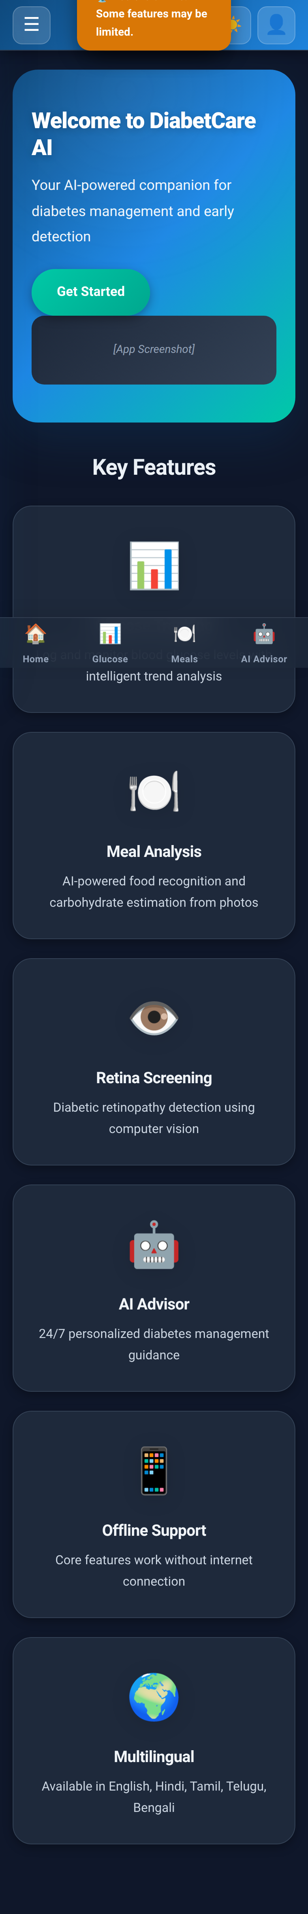
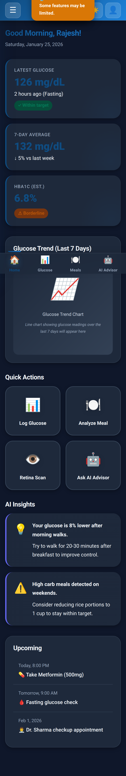
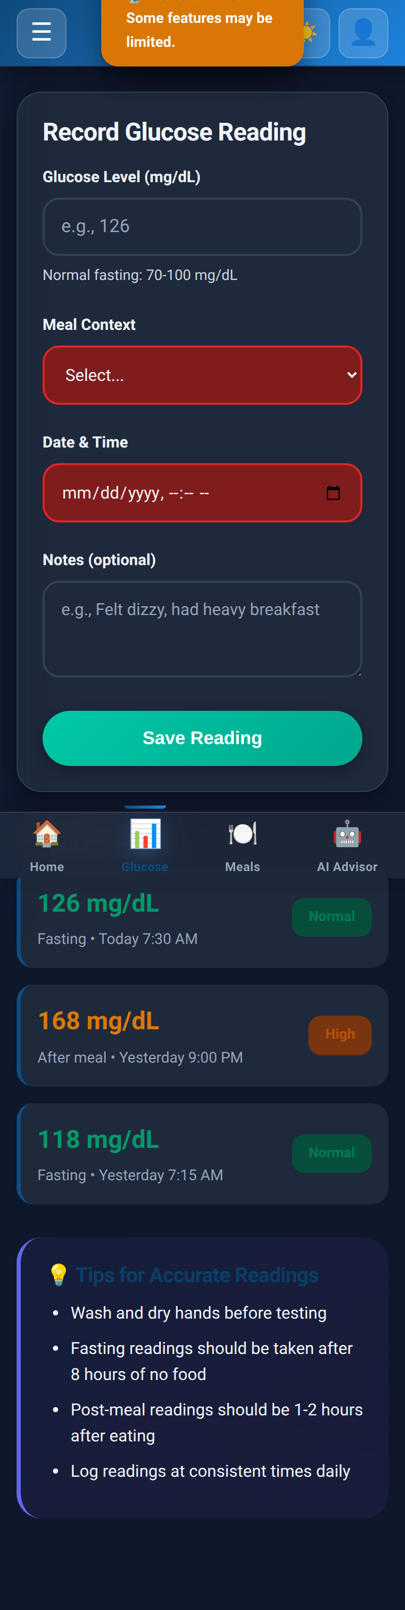
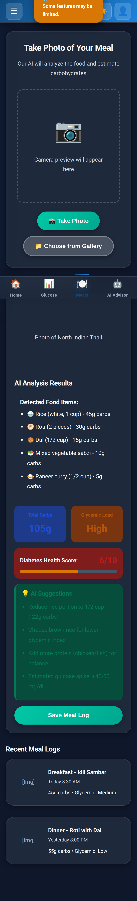
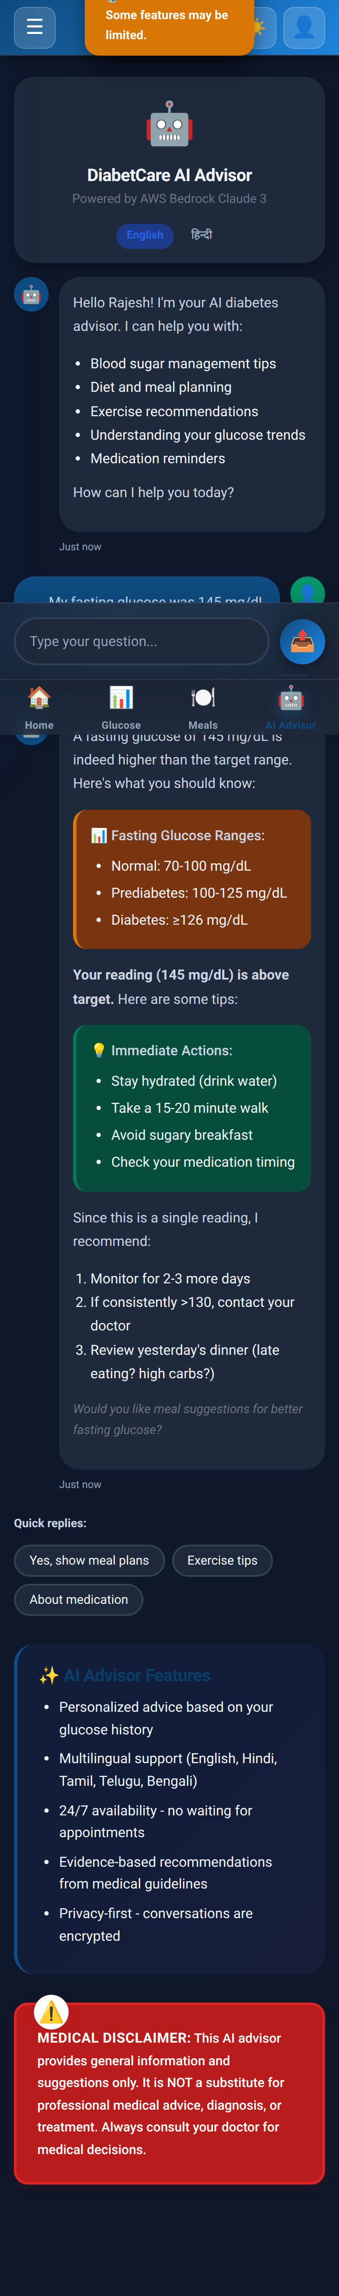
List of features offered by the solution

Slide 7
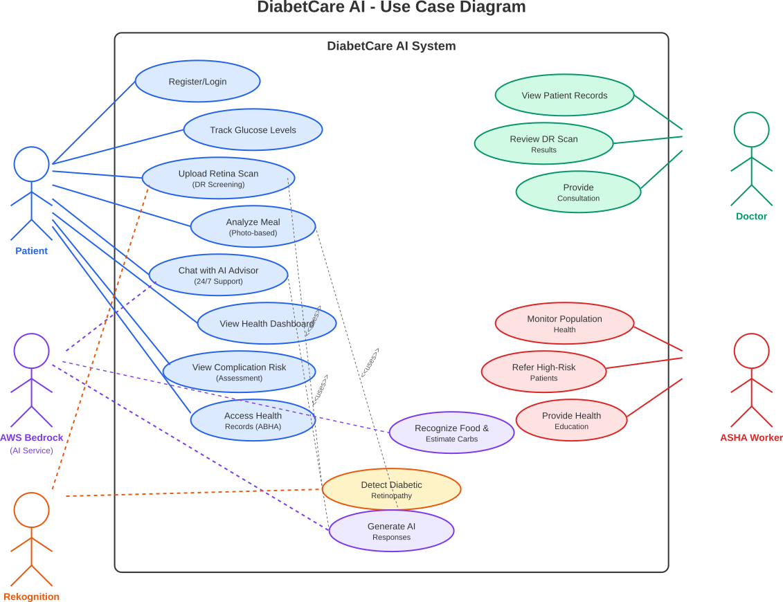
Use-case diagram

Slide 8
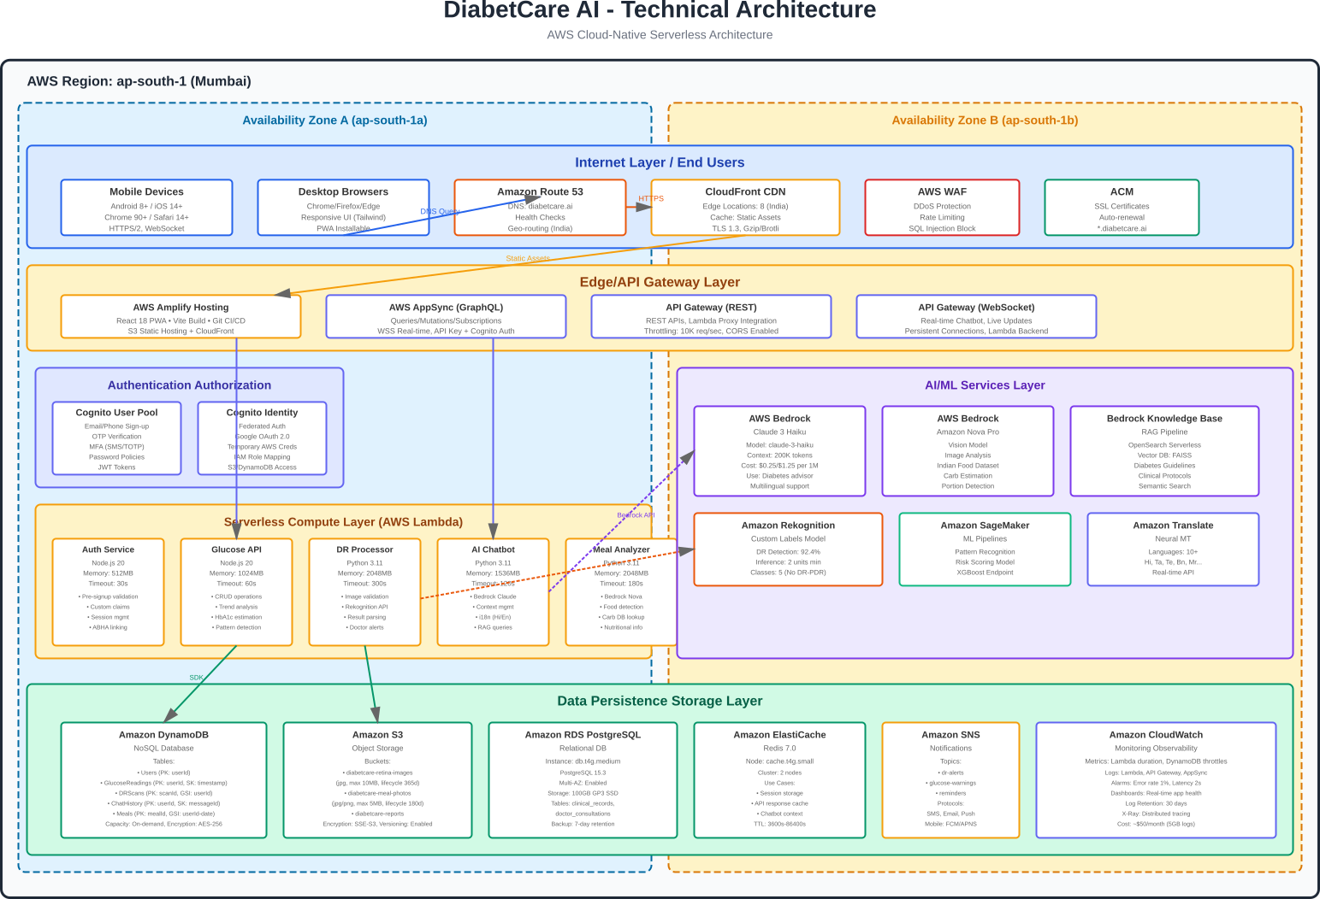
Architecture diagram of the proposed solution:

Slide 9
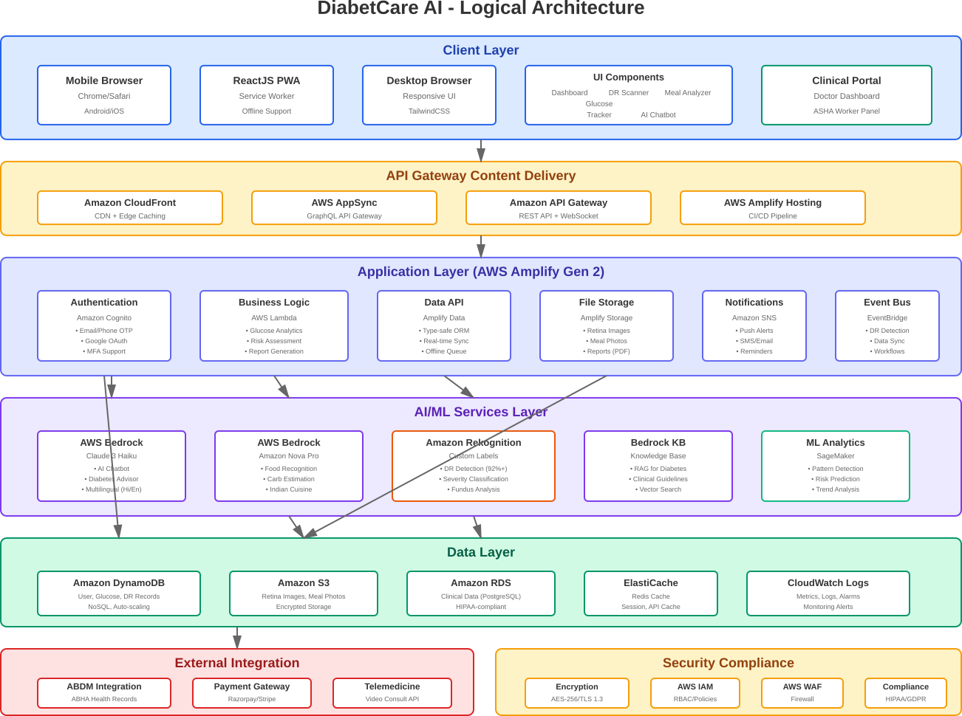
Technologies to be used in the solution:

Slide 10
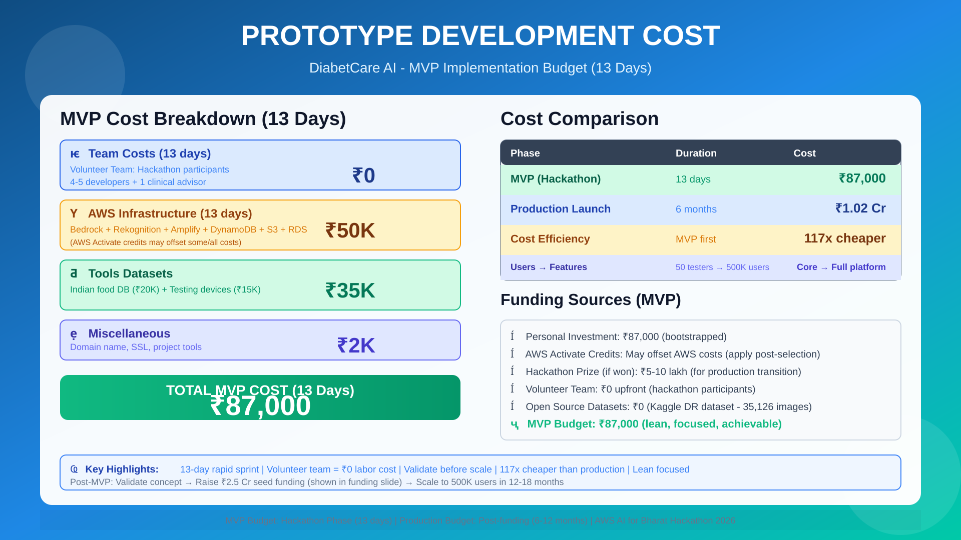
Estimated implementation cost (Prototype):

Slide 11


